Slide 1

Rumor Influence
Minimisation
\
Exploratory Project

Slide 2

ABOUT THE Problem…
Rumour is a piece of information that has not been verified, meaning the person telling it does not know it is true or false.
Rumour is a potentially harmful social phenomenon that has been observed in the human societies in all times.
Rumour blocking is a serious problem in large-scale social networks.
Malicious rumours could cause chaos in society and hence need to be blocked as soon as possible after being detected.
The rising development of large scale social networks like Facebook, Twitter, etc. people are able to share any kind of knowledge with each other online.
Spreading of Rumours
in a social network

Slide 3
ABOUt the Problem…
As every coin has two sides, this also has its own pros and cons. On one hand, people can share their innovations, ideas, happening topics, etc.
On the other hand, these social networks may become the channel for spreading the rumours.
For example, if someone posts a rumour about an upcoming earthquake, which will cause chaos among the public.
Undoubtedly, these malicious rumours should be stopped as soon as possible once detected so that their negative influence can be minimised.

Slide 4
GOAL…
Most of the work concentrates on maximising the positive information through social networks based on the IC (Independent Cascade) model. On the other side, the negative influence minimisation problem has less attention.
So, strategies for blocking malicious rumour users and minimising the influence of those rumours should be developed. Rumour propagation is reduced by blocking the number of nodes or number of links in a social network.
Our goal is to minimise the influence of the rumour, that is, the number of users that have accepted and sent the rumour, by blocking a certain subset of nodes.
Once the rumour is detected, it should be stopped at the earliest in order to reduce the negative influence.
This can be achieved by blocking certain subset of nodes as this reduces rumour propagation.
Rumour propagation is reduced by blocking the number of nodes or number of links in a social network.
Let us try to analyse few algorithms to achieve rumour minimisation.

Slide 5
Social Network Analysis …
Social Network Analysis (SNA) is the process of investigating social structures through the use of networks and graph theory.
It characterises networked structures in terms of nodes (individual people or things within the network) and the edges (interactions) that connect them.
These networks are often visualised through socio-grams in which nodes are represented as points and edges are represented as lines which help us to assess the networks qualitatively by varying the visual representation of their nodes and edges to reflect attributes of interest.
A directed graph G=(V,E) consists set of users denoted by node V and the relationship between users represented by edges E.
The random graph denotation of online social networks.
Nodes with different colours illustrate the different communities they belong to.
The size of the nodes indicates their degree or “influence” in the social network.
The bigger the node, higher is its degree, the more influential it is, and contributes more to rumour propagation.

Slide 6

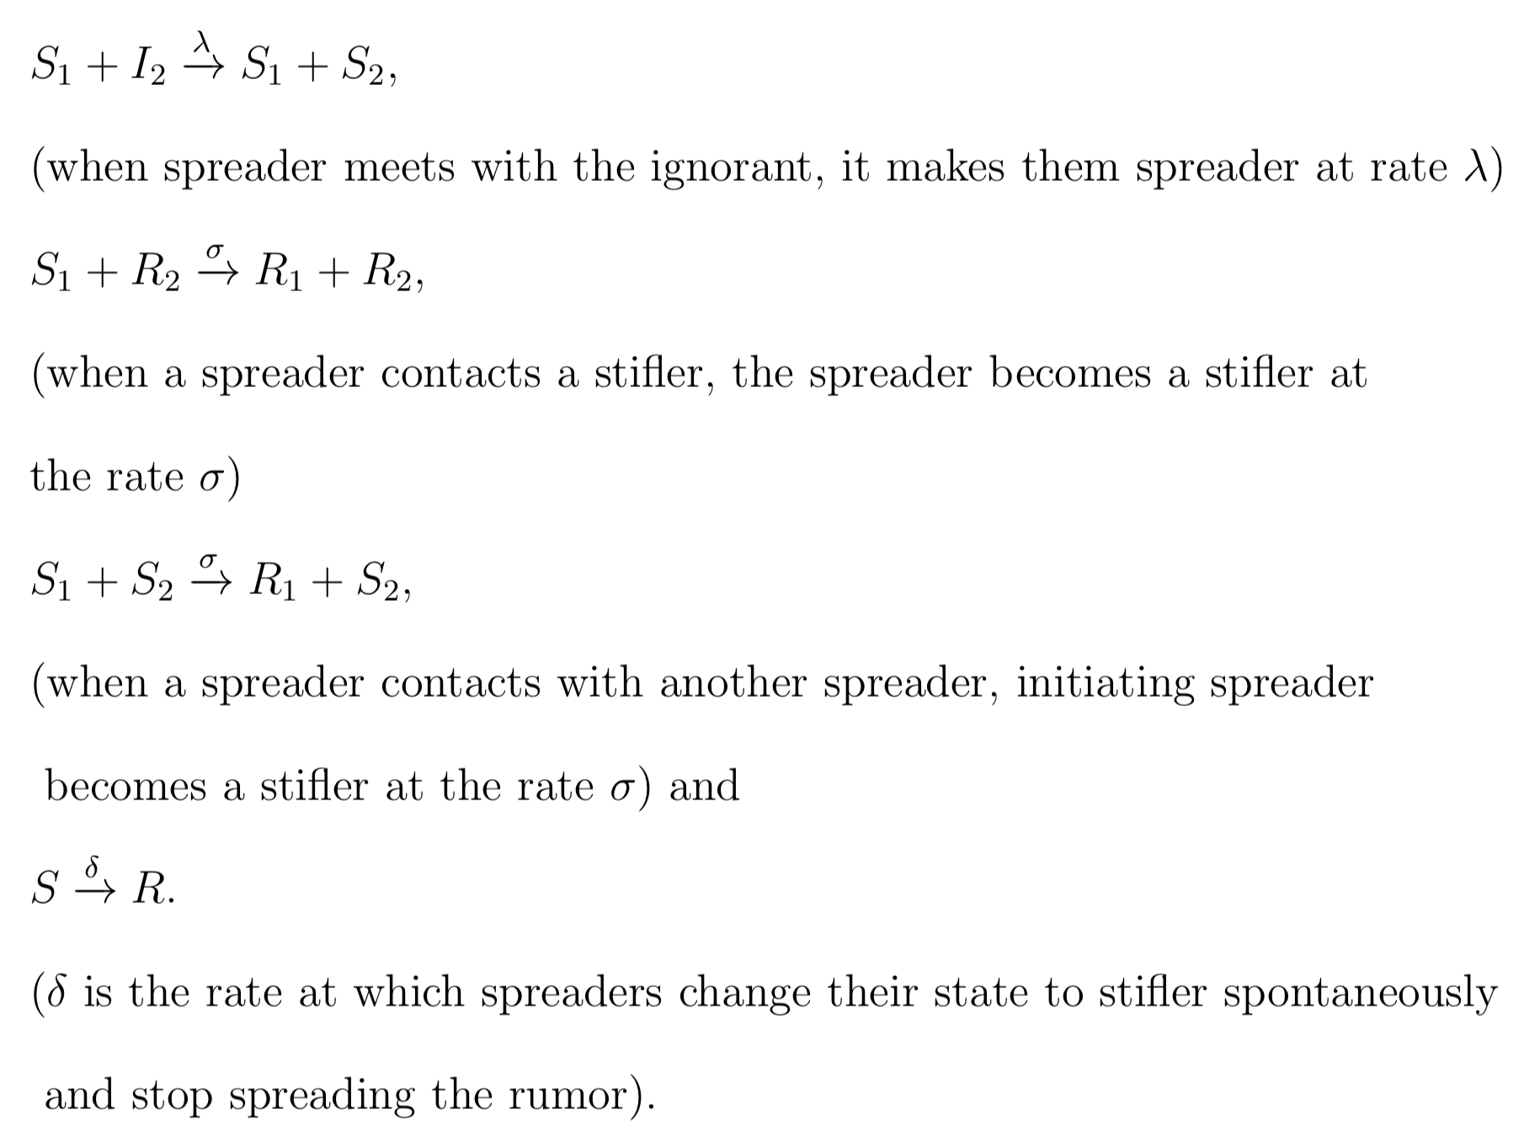

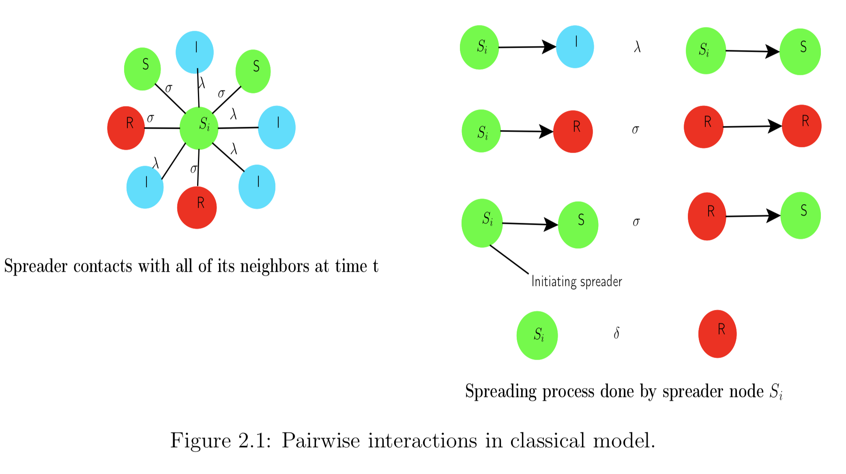
RUMOUR DIFFUSION MODEL…
MACROSCOPIC / EPIDEMIC MODEL-
Rumor diffusion mechanism is similar with that of epidemic propagation.
SIR Model- In this model, nodes are in one of the three categories — Infected (the nodes who already accepted the rumour and spread it, ignorant), Susceptible (the nodes who hear the rumour and also actively spread it, spreader) and Recovered (the nodes who hear the rumour but do not spread it further, stifler).
The rumour is propagated through the nodes by pairwise contacts between the spreaders and other nodes in the network.
These contacts can only take place along the edges of undirected graph of complex network.

Slide 7
Rumour diffusion model…
The other macroscopic models involve SI, SIS and SIRS models.
SI model- Initially nodes are susceptible (S) and can be infected (I) with propagated rumours in the SI model. Susceptible nodes are uninfected nodes having infected neighbours and therefore have a higher probability of becoming infected and a contaminated node remains infected forever. SI model is not viable as it does not take into account that contaminated users can be cured after having been contaminated.
SIS model- In the SIS model, the probable states are yet again susceptible (S) and infected (I), but in this model, when susceptible nodes become contaminated they can cure back to susceptible after some period.
SIRS model- In SIRS model, a recovered node can again become a susceptible node with some probability.

Slide 8
RUMOUR DIFFUSION MODEL…
MICROSCOPIC MODELS-
The known models in this category are Independent Cascades(IC) and Linear Threshold (LT) Models.
LT Model- In LT model, each node in the network selects a random threshold value, then at each time step inactive node gets influenced by all its active neighbours. The inactive node turns into active once the total weight of all its incoming neighbours reaches a threshold value.
IC Model- At one given instance, the node has only one chance to activate one of its inactive neighbouring nodes. The whole propagation process proceeds in discrete time steps. Initially, the cascade is triggered by a set of activated nodes.
Both LT and the IC models are majorly utilised to maximise the influence of spread in network.
IC Model

Slide 9


RUMOUR influence minimisation …
Rumor influence minimisation addresses the problem of minimising the propagation effect of undesirable rumours in social networks.
The rumour influence minimisation problem is converse to the classic influence maximisation problem.
The figure(2) beside illustrates the mechanism of rumour blocking in social networks.
It shows both the normal rumour propagation process without any blockage in the social network and also the process when a set of nodes in the path of rumour propagation are blocked.
Figure (1)
Figure (2)

Slide 10

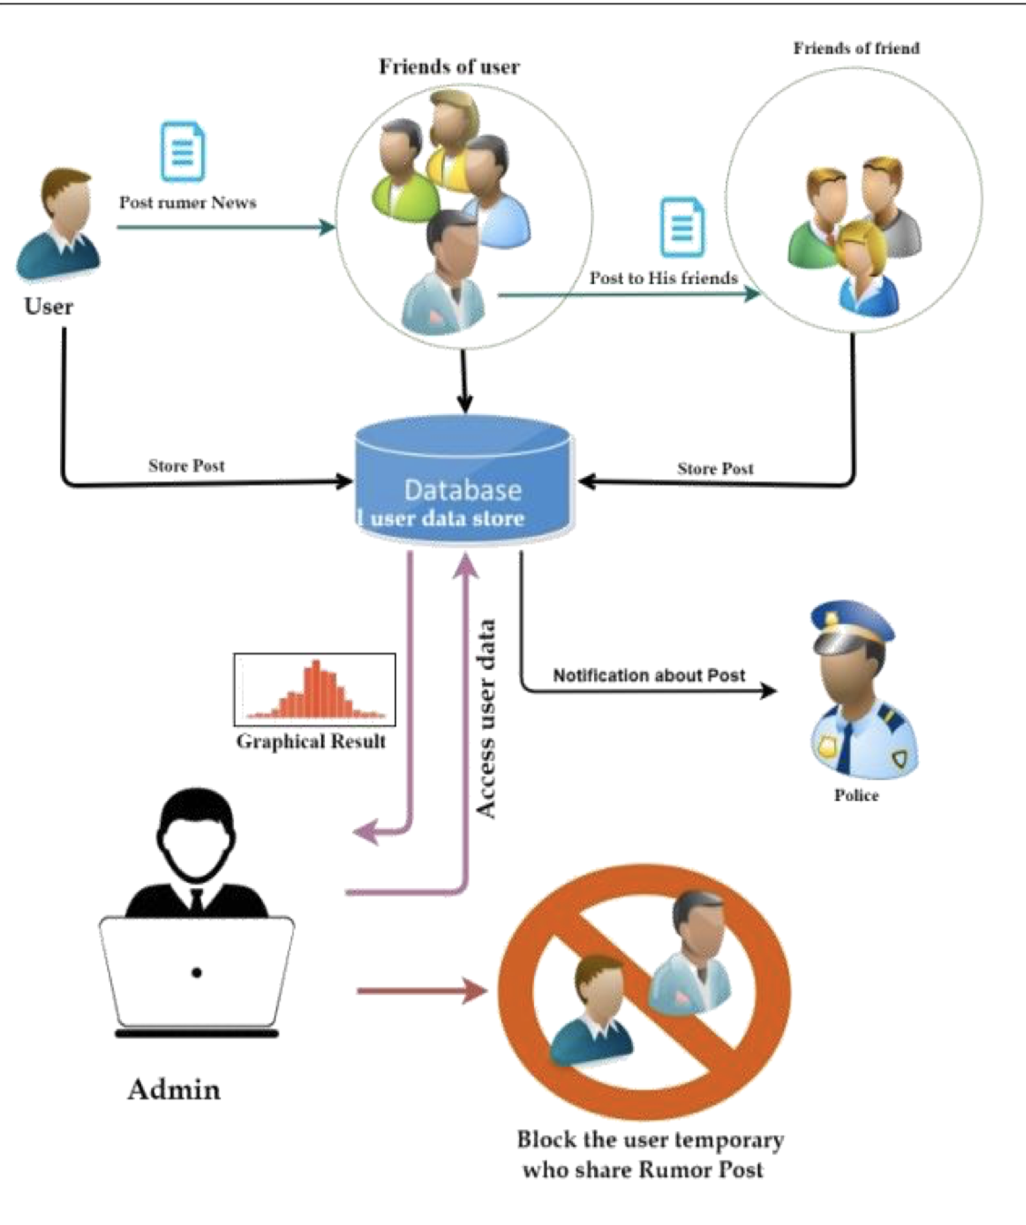
ALGORITHM…
Algorithm 1- Greedy Algorithm
Let A0 be the original network coefficient matrix before any nodes are blocked.
The proposed Greedy algorithm tries to block the rumour as fast as possible to prevent the rumour from further propagation.
The working mechanism is as follows- At time t0 when we detect the rumour, we immediately select all K nodes in our budget and block them (i.e., remove all the links of it so that it cannot communicate with its neighbours).
Mathematically, the Greedy algorithm aims to minimise the likelihood of inactive nodes getting activated at t1, i.e., the next time stamp after the rumour is detected.
It is a kind of static blocking algorithm.

Slide 11
ALGORITHM…
Algorithm 2- Dynamic Blocking Algorithm
Different from the greedy blocking algorithm, the dynamic blocking algorithm blocks the K nodes in separated steps. In this case, the blocking strategy is split into several rounds and each round can be regarded as a greedy algorithm.
Instead of blocking K candidates at the moment of detection, as in the previous static blocking strategy, this dynamic approach is carried out in a progressive way.
The working of the dynamic algorithm is as follows-at the very first stage of blocking, we select a number k1 nodes to block based on the Edge matrix and previously infected nodes.

Slide 12
ALGORITHM…
Algorithm 2- Dynamic Blocking Algorithm
In the next round, we move forward with the rumour diffusion, and then use the updated status to block additional k2 nodes. The blocking process continues at each following instants until the budget runs out at a moment t , which can be expressed as Σ kj = K.
In real implementation, we decrease k as time goes by, and a practical example is kj=(2^{-j} )*K.
The activation likelihood of a given moment is a variable which depends on the temporal Edge matrix and previous status. So, we take advantage of instantaneous information all through the process,
Rather than sparing all the efforts at once, we apply consequent force to block the diffusion of rumours. So, this method is more efficient than the static methods.

Slide 13
CONCLUSION…
In this project, we focused on the rumor minimisation problem in social networks and studied two algorithms to achieve the same. We observe that, the dynamic algorithm is more efficient than the static greedy algorithm. Both of these algorithms disconnect the affected nodes so that the rumor spread is minimised. The dynamic algorithm performs this task in discrete intervals of time whereas the greedy algorithm performs it at once.

Slide 14
THANK YOU!!
Presented by-
Palakur Eshwitha Sai
18123014
Mathematics and Computing
Supervised by-
Dr. Lavanya Selvaganesh

